Slide 1

Face Detection using Amazon Rekognition
Computer Vision Lab

Slide 2
Task Overview
1. Create a Collection
2. Upload an Image
3. Add Image to Collection
4. View Bounding Box
5. List Faces in Collection
6. Search for a Face
7. Draw Bounding Box
8. Delete Collection

Slide 3
Task 1: Create a Collection
Using Amazon Rekognition to create a collection.
Collections are used to store facial information for each face.
Code:
client.create_collection(CollectionId='Collection')

Slide 4

Task 2: Upload an Image
Uploading an image to the notebook to detect a face.
Here, I used an image of me.
Code:
filename = 'me.png'
faceimage = io.imread(filename)
plt.imshow(faceimage)

Slide 5
Task 3: Add Image to Collection
Adding the uploaded image to the collection for face recognition.
Code:
client.index_faces(CollectionId='Collection', Image={'Bytes': fimage.read()}, ExternalImageId=externalimageid)

Slide 6
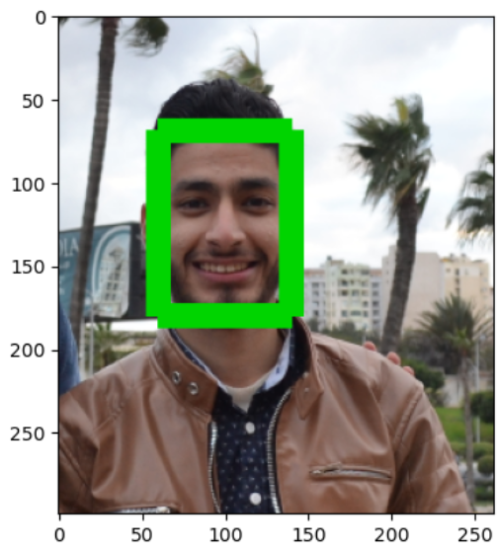
Task 4: View Bounding Box
Displaying the bounding box created around the face in the image.
Code:
points = ((left,top),(left+width,top),(left+width,top+height),(left,top+height),(left,top))
draw.line(points,fill='#00d400', width=15)

Slide 7
Task 5: List Faces in Collection
Listing all faces indexed in the collection.
Code:
client.list_faces(CollectionId=collection_id, MaxResults=2)
Output: {'FaceId': '851a98dc-b6c8-4ddc-9de8-83b8a6d2f34f', 'BoundingBox': {'Width': 0.30296799540519714, 'Height': 0.36957401037216187, 'Left': 0.23176999390125275, 'Top': 0.23274299502372742}, 'ImageId': '407cc43d-e89d-3ac1-a35f-22df75c5efe9', 'ExternalImageId': 'me.png', 'Confidence': 99.99320220947266, 'IndexFacesModelVersion': '7.0'}

Slide 8

Task 6: Search for a Face
Searching the collection for a face that matches an uploaded image.
Code:
client.search_faces_by_image(CollectionId=collection_id, Image={'Bytes': timage.read()})

Slide 9
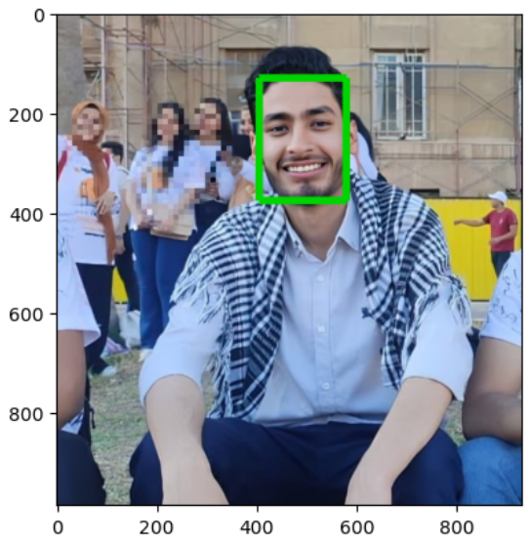
Task 7: Draw Bounding Box
Drawing the bounding box around the matching face found in Task 6.

Slide 10
Task 8: Delete Collection
Cleaning up by deleting the collection after all tasks are completed.
Code:
client.delete_collection(CollectionId=collection_id)

